Slide 1
CAPSTONE PROJECT
Credit Card Fraud Detection
Presented By:
MOHAMED HUMAYUN BASHA
-CARE College of Engineering
-Mechanical Engineering

Slide 2
OUTLINE
Problem Statement
Proposed System/Solution
System Development Approach
Algorithm & Deployment
Result
Conclusion
Future Scope
References

Slide 3
PROBLEM STATEMENT
The aim of the project is to predict fraudulent credit card transactions using machine learning models.
This is crucial from the bank’s as well as customer’s perspective.
The banks cannot afford to lose their customers’ money to fraudsters.
Every fraud is a loss to the bank as the bank is responsible for the fraud transactions.

Slide 4
PROPOSED SOLUTION
1. Data understanding and exploring
2. Data cleaning
• Handling missing values
3. Exploratory data analysis
• Univariate analysis
• Bivariate analysis
4. Prepare the data for modelling
• Check the skewness of the data and mitigate it for fair analysis
• Handling data imbalance as we see only 0.172% records are the fraud
transactions.
5. Split the data into train and test set
• Scale the data (normalization)
6. Model building
• Train the model with various algorithm such as Logistic regression, SVM,
Decision Tree, Random forest, XGBoost etc.
• Tune the hyperparameters with Grid Search Cross Validation and find the
optimal values of the hyperparameters.
7. Model evaluation
• As we see that the data is heavily imbalanced, Accuracy may not be the
correct measure for this particular case.

Slide 5
SYSTEM APPROACH
A systematic approach to credit card fraud detection involves leveraging various techniques and technologies to identify and prevent fraudulent activities effectively.
Data Collection and Preprocessing:
Gather transactional data from credit card issuers, including transaction amounts, timestamps, merchant information, and customer demographics.
Model Selection:
Choose appropriate machine learning models for credit card fraud detection based on the characteristics of the data and the desired level of accuracy.
Training and Evaluation:
Split the preprocessed data into training and testing sets to train the selected models and evaluate their performance.

Slide 6
Continuous Monitoring and Improvement: Monitor the performance of deployed models in real-time and collect feedback on their effectiveness in detecting fraud. Collaboration and Information Sharing: Collaborate with other financial institutions, regulatory agencies, and industry partners to share insights and best practices for fraud detection and prevention. Participate in fraud detection networks and consortiums to leverage collective intelligence and enhance the effectiveness of fraud detection efforts across the industry. Systematic approach, financial institutions and credit card issuers can develop robust fraud detection systems that effectively identify and mitigate fraudulent activities, thereby safeguarding the interests of cardholders and maintaining trust in the financial ecosystem.
SYSTEM APPROACH - CONT

Slide 7
ALGORITHM & DEPLOYMENT
Local Outlier Factor
The Local Outlier Factor or LOF algorithm is an unsupervised anomaly detection method. It computes the local deviation of a given a data point with respect to its neighbors. Local Outlier Factor considers as outliers the samples that have a substantially lower density than their neighbors.
Isolation Forest Algorithm
The Isolation Forest ‘isolates’ observations by randomly selecting a feature and then randomly selecting a split value between the maximum and minimum values of the selected feature. Since recursive partitioning can be represented by a tree structure, the number of splitting required to isolate a sample is equivalent to the path length from the root node to the terminating node. This path length, averaged over a forest of such random trees, is a measure of normality and our decision function. Random partitioning produces noticeably shorter paths for anomalies. Hence, when a forest of random trees collectively produce shorter path lengths for particular samples, they are highly likely to be anoma.

Slide 8
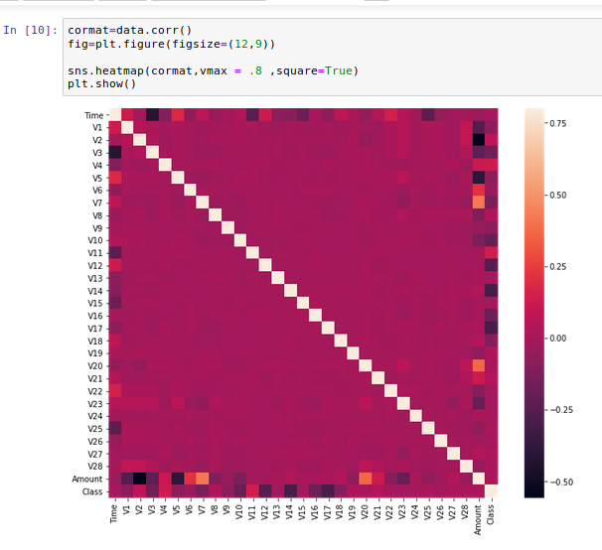
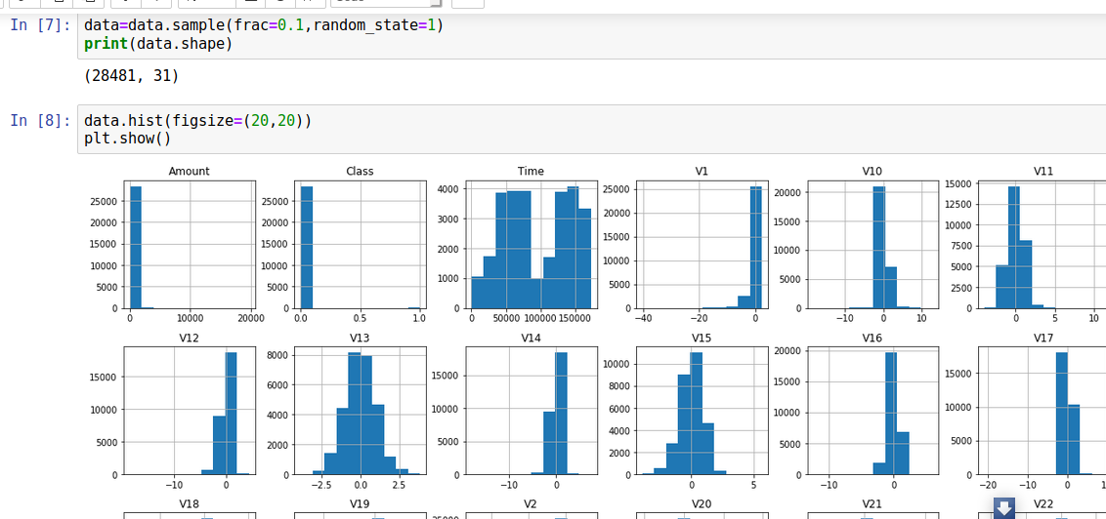
RESULT

Slide 9
CONCLUSION
In conclusion, credit card fraud detection is a critical component of ensuring the security and integrity of financial transactions in today's digital age. As fraudulent activities continue to evolve and become more sophisticated, it is imperative for financial institutions and credit card issuers to employ advanced techniques and technologies to detect and prevent fraud effectively.. By investing in advanced fraud detection solutions and adopting a proactive and collaborative approach, financial institutions can mitigate fraud risk, minimize losses, and uphold the integrity of the credit card ecosystem for the benefit of all stakeholders involved.

Slide 10
FUTURE SCOPE
The future scope for credit card fraud detection is promising, driven by advancements in technology, data analytics, and machine learning.
Advanced Machine Learning Algorithms:
Continued development of machine learning algorithms, including deep learning and reinforcement learning, to enhance fraud detection accuracy and adaptability to evolving fraud patterns.
Big Data Analytics:
Leveraging big data analytics techniques to process and analyze large volumes of transactional data in real-time, enabling faster and more accurate detection of fraudulent activities.
Behavioral Biometrics:
Adoption of behavioral biometrics, such as keystroke dynamics, mouse movements, and voice recognition, to authenticate users and detect anomalies in their behavior patterns indicative of fraud.
Overall, the future of credit card fraud detection lies in harnessing the power of advanced technologies, data analytics, and collaboration to develop robust, adaptive, and proactive solutions that safeguard the integrity of electronic payment systems and protect the interests of cardholders and financial institutions alike.

Slide 11
REFERENCES
Visit https://www.irjet.net/archives/V5/i11/IRJET-V5I11304.pdf
Visit https://acadpubl.eu/jsi/2018-118-7-9/articles/7/31.pdf
Visit https://arxiv.org/pdf/1811.02196.pdf
Visit https://towardsdatascience.com/anomaly-detection-with-isolation-forest-visualization-23cd75c281e2

Slide 12
THANK YOU

